Slide 1
Nervous tissue
Ass. Proffesor .Dr. Emad Al-Radhi
Ph.D.MOLECULAR cytology

Slide 2
Learning objective
1-Definition the nervous tissue
2- Structures of the neurons
3- Classified of Neurons
(Structural and Functional )

Slide 3
Case Study
Layla is worried about her mother. She is 60 years old started to forget things
since 6 month ago like monthly visit to her physician, and the date of her lovely
grandson's birthday, over the last week she frequently forgets where she put her
personal stuff, the doctor examined her and told her she might have Alzheimer
(Most common progressive neurlogical disease in which the brain size is
decreased and brain cells die,neuron).

Slide 4
Definition
Nervous tissue
- is the primary tissue that composes the
central nervous system and
the peripheral nervous system.

Slide 5
Neurons are the basic unit of nervous tissue. They are responsible for sensing stimuli and transmitting signals to and from different parts of an organism.
The nerve is like epithelium derived from ectoderm. In addition to neurons, specialized cells known as glial cells serve to support nerve cells.

Slide 6
What Types of the nerve cells?
Nervous tissue consists of two major types of cells:
1- Neurons: responsible for conduction, propagation, and reception of nervous impulses. Processes called axons or dendrites extend from these cells.
2- Glial cells: (Neuroglia) cells associated with neurons. No axons or dendrites. These cells are involved in nutrition, support, insulation, protection of neurons.

Slide 7
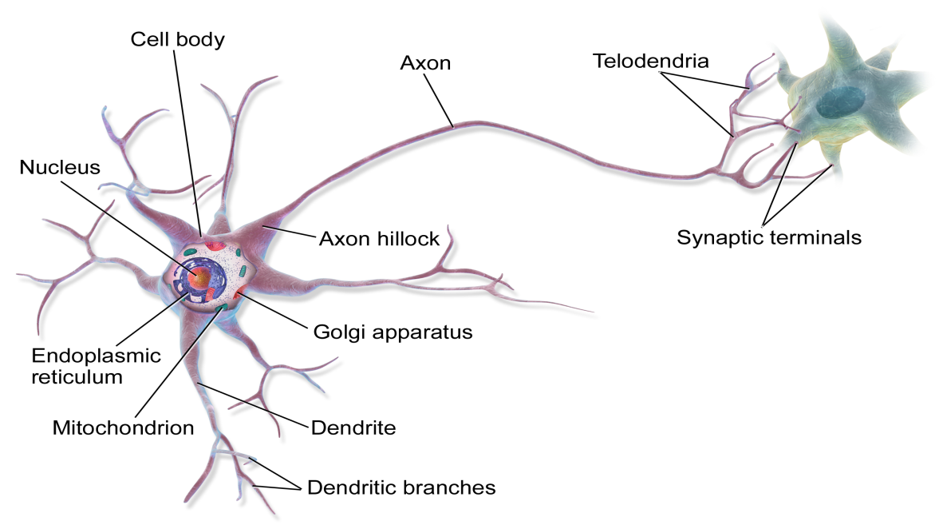
Neurons
The basic unit of nervous tissue, neurons, they are cells have the ability to respond to a stimulus and convert it into an action potential.

Slide 8
LO.2 The structure of Neuron
1-Nerve cell body
2-Axon
3-Dendrites

Slide 9
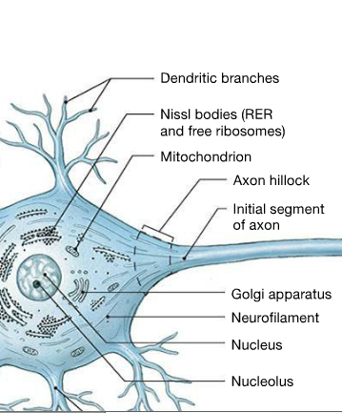

Slide 10
1-Nerve cell body
Under Electron Microscope, The Cell Body Contain Highly Developed Rough Endoplasmic Reticulum Organized Into Aggregation Of Parallel Cisternae. Between These Cisternae There Are Numerous Polyribosomes Suggestion That These Cell Synthesize Both Structural Proteins And Neurotransmitter Proteins Such As Acetylcholine.

Slide 11
Under The Light Microscope, The Rough Endoplasmic Reticulum And Free Ribosomes Appear As Basophilic Granular Areas Called Nissl Body. The Nissl Body, Also Known As Nissl Or Tigroid Substance, Is A Large Basophilic Granular Bodies Found In Neuron Except The Axon Hillock Which Is Free.

Slide 12
2-Axon(nerve fiber)
Is a single thread-like extension from cell .These axons is usually called nerve fibers in the central nervous system and peripheral nervous system. A nerve fiber may be myelinated and/or unmyelinated

Slide 13
3-Dendrites
1-They are the short.
2- tapering and branched projections of
neuron .
3- that act to propagate the electrochemical stimulation received from other neural cells to the cell body .
4- Their cytoplasm contains Nissel bodies, mitochondria and other organelles but lacking Golgi apparatus

Slide 14
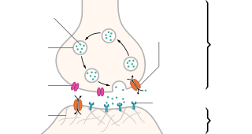
In the nervous system, a synapse is a structure that permits a neuron (or nerve cell) to pass an electrical or chemical signal to another neuron or to the target effecter cell.
What is the Nerve synapses

Slide 15
What are the classified of Synapses
1-Axodendritic
2-Axosomatic
3-Axoaxonic
4-Dendrodendritic

Slide 16
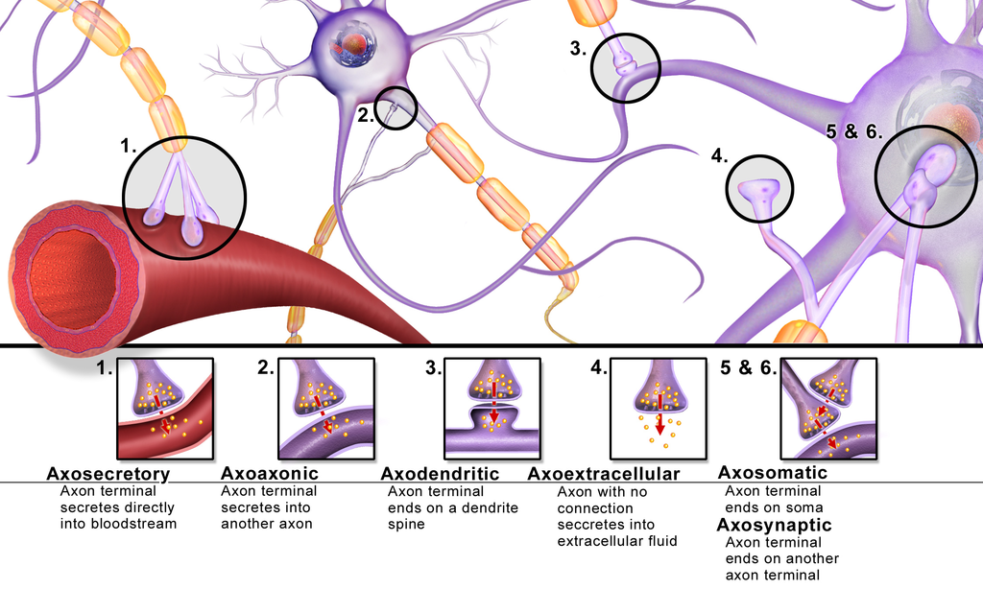
Synapses

Slide 17
1-Structural classification
A- Multipolar neurons
B- Bipolar neurons
C- Pseudounipolar neurons
D- Unipolar brush cells
E-Anaxonic neurons
2-Functional classification
1-Motor (efferent) neurons
2-Sensory (afferent) neurons
3-Interneurons (association neurons)
What is the classified of Neurons

Slide 18
A- Multipolar neurons
Have 3 or more processes coming off the soma (cell body). They are the major neuron type in the CNS and include interneurons and motor neurons.

Slide 19
B- Bipolar neurons
Sensory neurons that have two processes coming off the soma, one dendrite and one axon, found in the retina of the eye , inner ear and in the olfactory area of the brain

Slide 20
C- Pseudounipolar neurons
Sensory neurons that have one process that splits into two branches, forming the axon and dendrite

Slide 21
D- Unipolar brush cells
Are excitatory glutamateric interneurons that have a single short dendrite terminating in a brush-like tuft of dendrioles. These are found in the granular layer of the cerebellum

Slide 22
E-Anaxonic neurons
With many dendrites but no true axon, do not produce action potentials, but regulate electrical changes of adjacent neurons. They are found in the brain and retina

Slide 23
1-Motor (efferent) neurons
with long axon use to transmit nerve impulses from the CNS to a muscle or gland through a spinal or cranial nerve, most of them are multipolar

Slide 24
2-Sensory (afferent) neurons
include all axons that transmit impulses from peripheral structure to the CNS, they are unipolar in structure

Slide 25
3-Interneurons (association neurons)
establish relationships among other neurons , forming complex
functional networks. they are generally multipolar or anaxonic and are
estimated to include 99% of the neurons in the human CNS.
mature neurons have little capacity for cell division and seldom
form tumors. the majority of brain tumors in adults involve actively
dividing neuroglia cells. most brain tumors have to be treated with
surgery or radiation therapy because of a blood-brain barrier

Slide 27
Neuroglial cells
Dr.Emad Al-Radhi
Ph.D. Molecular cytology

Slide 28
The Neuroglia (Glial cells)
They are referred to as neuroglial cells or simply glia cells don't participate in the receiving and sending electrical impulses. Various types of neuroglia are found in the brain . Those are the cells which support, and protect the neurons within the :
CNS
(central neuroglia
PNS (peripheral neuroglia

Slide 29
Neuroglial cells
1- Physical support (protection) for neurons and Insulation for nerve cell bodies and processes.
2- Repair of neuronal injury and metabolic exchange between the vascular system and the neurons of the nervous system.
3- To destroy pathogens and remove dead neurons. The glial cells are smaller but are more in number unlike the nerve cells glial cells
4- have the ability to divide.
What the main functions of the glial cells

Slide 30
Types of neuroglia cells
1- Central neuroglia cells ( CNS)
A- Astrocytes
B- Oligodendrocytes
C- Microglia
D- Ependymal cells
2- Peripheral neuroglia cells (PNS)
A- Schwann cells or neurolemmocytes
B- Satellite cells

Slide 31
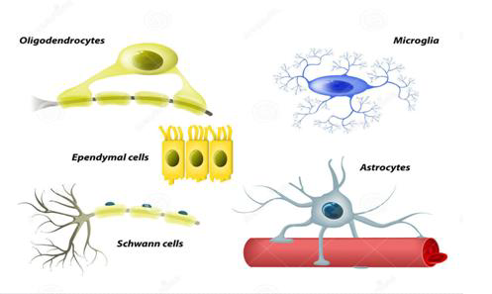
Neuroglial cells

Slide 32
A- Astrocytes
They are large and star shaped consist of many branched cytoplasmic processes and it contains intermediate filaments composed of a distinct protein called glial fibrillary acidic protein(GFAP). Astrocyte have perivascular feet to form blood-brain barrier (BBB). Astrocytes provide nutrients to neurons and produce a hormone known as glia-derived growth factor, which someday might be used as a cure for Parkinson disease and other diseases caused by neuron degeneration.

Slide 33
There are two types of astrocytes in the CNS
1- Protoplasmic astrocytes
these cells have short and thick processes with many branches. they are mainly located in the gray matter of brain and spinal cord. the main functions is support neurons in a metabolism.
2- Fibrous astrocytes
these cells have long and thin processes with few branched. they are mainly located in the white matter of brain and spinal cord. the main functions is binding and supporting the neurons.

Slide 34
B-Oligodendrocytes
they are a type of glial cell in the central nervous system that creates myelin sheaths around the axons of neurons. the creation of myelin allows for the formation of myelin sheaths around neuronal axons. this myelin sheath allows for action potentials to travel down the axon much more efficiently and quickly compared to unmyelinated axons.

Slide 35
C- Microglia
they are small elongated cells with short process, nuclei of microglial cells can be recognized in routine hematoxilin and eosin preparations by their dense elongated structure. its originate from bone marrow (monocytes) while the other glia cells originate from neural tubes. these cells have capacity for phagocytosis to eliminate the foreign materials. they possess a small, round, condensed nucleus and only a few short processes.

Slide 36
D- Ependymal cells
they are low columnar epithelial lining the ventricles of the brain and central ,canal of the spinal cord. in some location ependymal cells have cilia like structure which facilitates the movement of cerebrospinal fluid (csf). ependymal form with blood vessels the choroid pluxes that form the csf. ependymal cells also involved with binding between neurons by distal folding processes

Slide 37
2- Peripheral neuroglia cells a- Schwann cells or neurolemmocytes

Slide 38
myelinating schwann cells wrap around axons of motor and sensory neurons to form the myelin sheath. membranes of schwann cells have a higher proportion of lipids than do other cell membranes and the myelin sheath serves to protect axons and maintain a constant ionic microenvironment required for action potentials. between adjacent schwann cells the myelin sheath shows small nodal gaps along the axon, called (Nodes of ranvier). the length of axon covered by one schwann cell is called the internodal segment and may be more than 1 millimeter .

Slide 39
Schwann cells
1- The conduction of nervous impulses along axons
2- Nerve development and regeneration, trophic support for neurons
3- Production of the nerve extracellular matrix
4- Modulation of neuromuscular synaptic activity
5- Presentation of antigens to T-lymphocytes.
divide.
What the main functions of the Schwann cells

Slide 40
Satellite cells
they are small cells form a covering layer over the large neuronal cell bodies in the ganglia (collection of neurons outside the CNS). satellite cells exert a trophic or supportive effect on these neurons, insulating, nourishing, and create a suitable microenvironment to the neurons.

